Slide 1

Crop recommendation
Guided by:
Mr. Amaresh
Mr. Smita Ranjan Dutta
Presented by:
Bijoy Laxmi Behera
Ajay – Binay Degree College
CDA, Sector-1, Cuttack, Odisha

Slide 2
CONTENT
Introduction
Technology Stack & Architecture
Database
Charts and Graphs
Limitations and Future Directions
Conclusion
Reference

Slide 3
INTRODUCTION
PROJECT OVERVIEW:
Analyzing a dataset to recommend suitable crops for agriculture.
IMPORTANCE:
Proper crop recommendations can optimize agricultural yield and sustainability.
OBJECTIVES:
Analyze data to understand patterns.
Train machine learning models to predict suitable crops.

Slide 4


Technology stack & Architecture
Crop Recommendation is built in the following architecture:
Python Programming Language
The core programming language used for the development of this project is Python. It provides the necessary libraries and modules for interacting with the database and developing the user interface.
Machine Learning (ML)
It is a branch of artificial intelligence (AI) that focuses on developing algorithms and models that enable computers to learn and make predictions or decisions without being explicitly programmed.

Slide 5



Pandas: For data manipulation and analysis.
NumPy: For numerical computing and handling arrays.
Matplotlib: For creating static plots and visualizations.
Seaborn: For statistical data visualization with an emphasis on aesthetics.
scikit-learn: For machine learning algorithms and evaluation metrics.
XGBoost: For gradient boosting machine learning.
LightGBM: For gradient boosting machine learning.
CatBoost: For gradient boosting machine learning.

Slide 6

database
The database used in this is a CSV file downloaded from Kaggle.
The dataset provided contains information about different crops along with various attributes. Each row represents a sample with information about the nutrient content (Nitrogen, Phosphorus, Potassium - N, P, K), temperature, humidity, pH level, rainfall, and the corresponding crop label.
The dataset includes samples for different crops, such as rice, wheat, maize, etc. Each crop has specific requirements regarding soil nutrients, climate conditions, and other factors. By analyzing this dataset, we can understand the relationships between these attributes and crop recommendations, potentially building machine learning models to predict suitable crops based on input conditions.

Slide 7
Here's a breakdown
N (Nitrogen): The amount of nitrogen in the soil, a vital nutrient for plant growth and development.
P (Phosphorus): The amount of phosphorus in the soil, essential for energy transfer within the plant and root development.
K (Potassium): The amount of potassium in the soil, is crucial for plant metabolism and overall health.
Temperature: The temperature in Celsius, which can influence plant growth and metabolism.
Humidity: The relative humidity, indicating the amount of moisture in the air, affecting plant transpiration and water uptake.
pH: The pH level of the soil, indicating its acidity or alkalinity, affecting nutrient availability to plants.
Rainfall: The amount of rainfall in millimeters, is an essential factor for crop growth and irrigation needs.
Label: The type of crop recommended based on the given soil and environmental conditions.

Slide 8
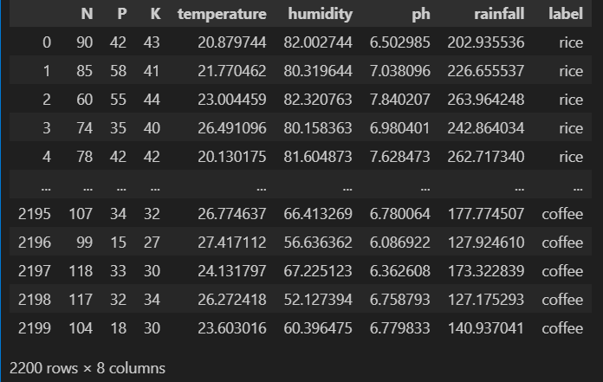
Sample Records:

Slide 9
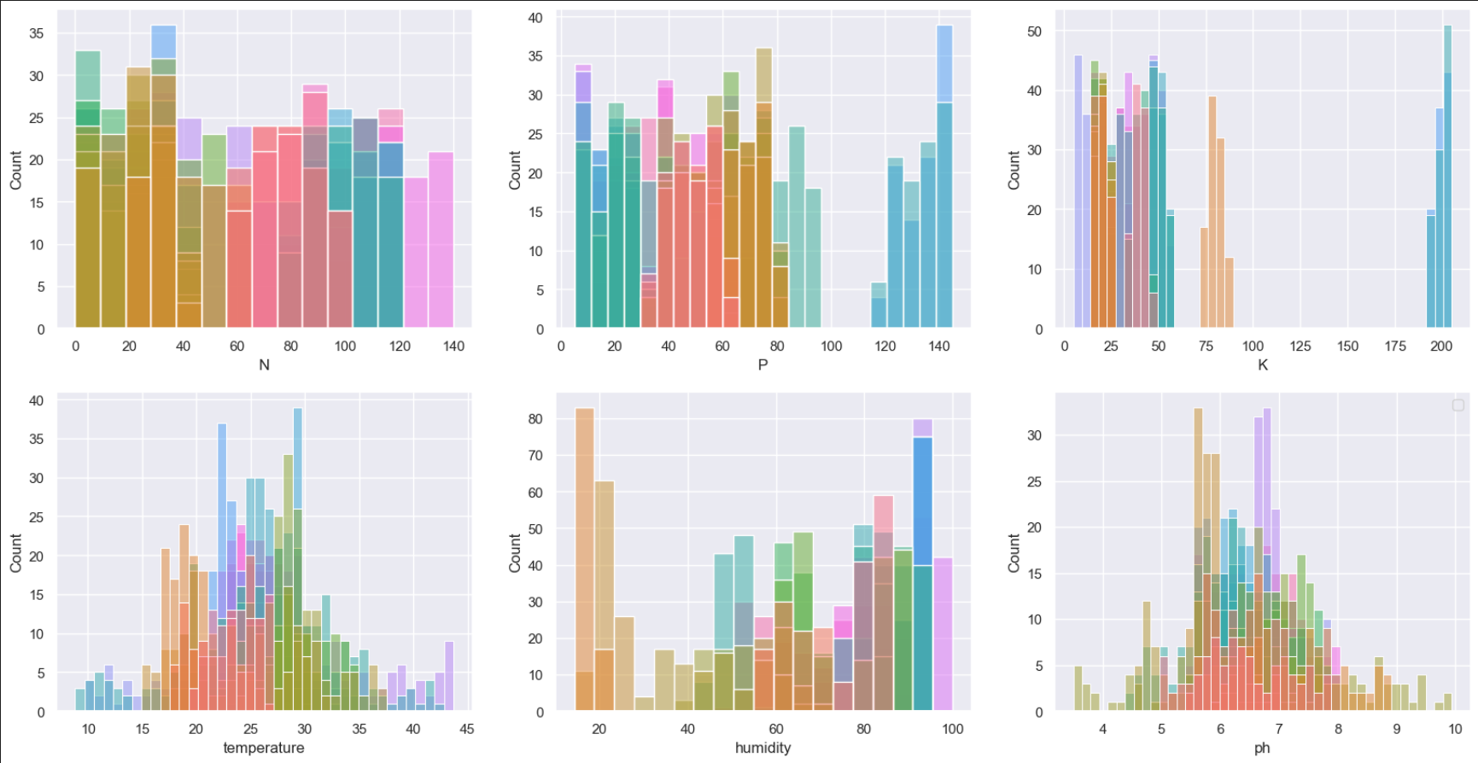
Chart & graphs
Histograms:
Visualize feature distributions.

Slide 10
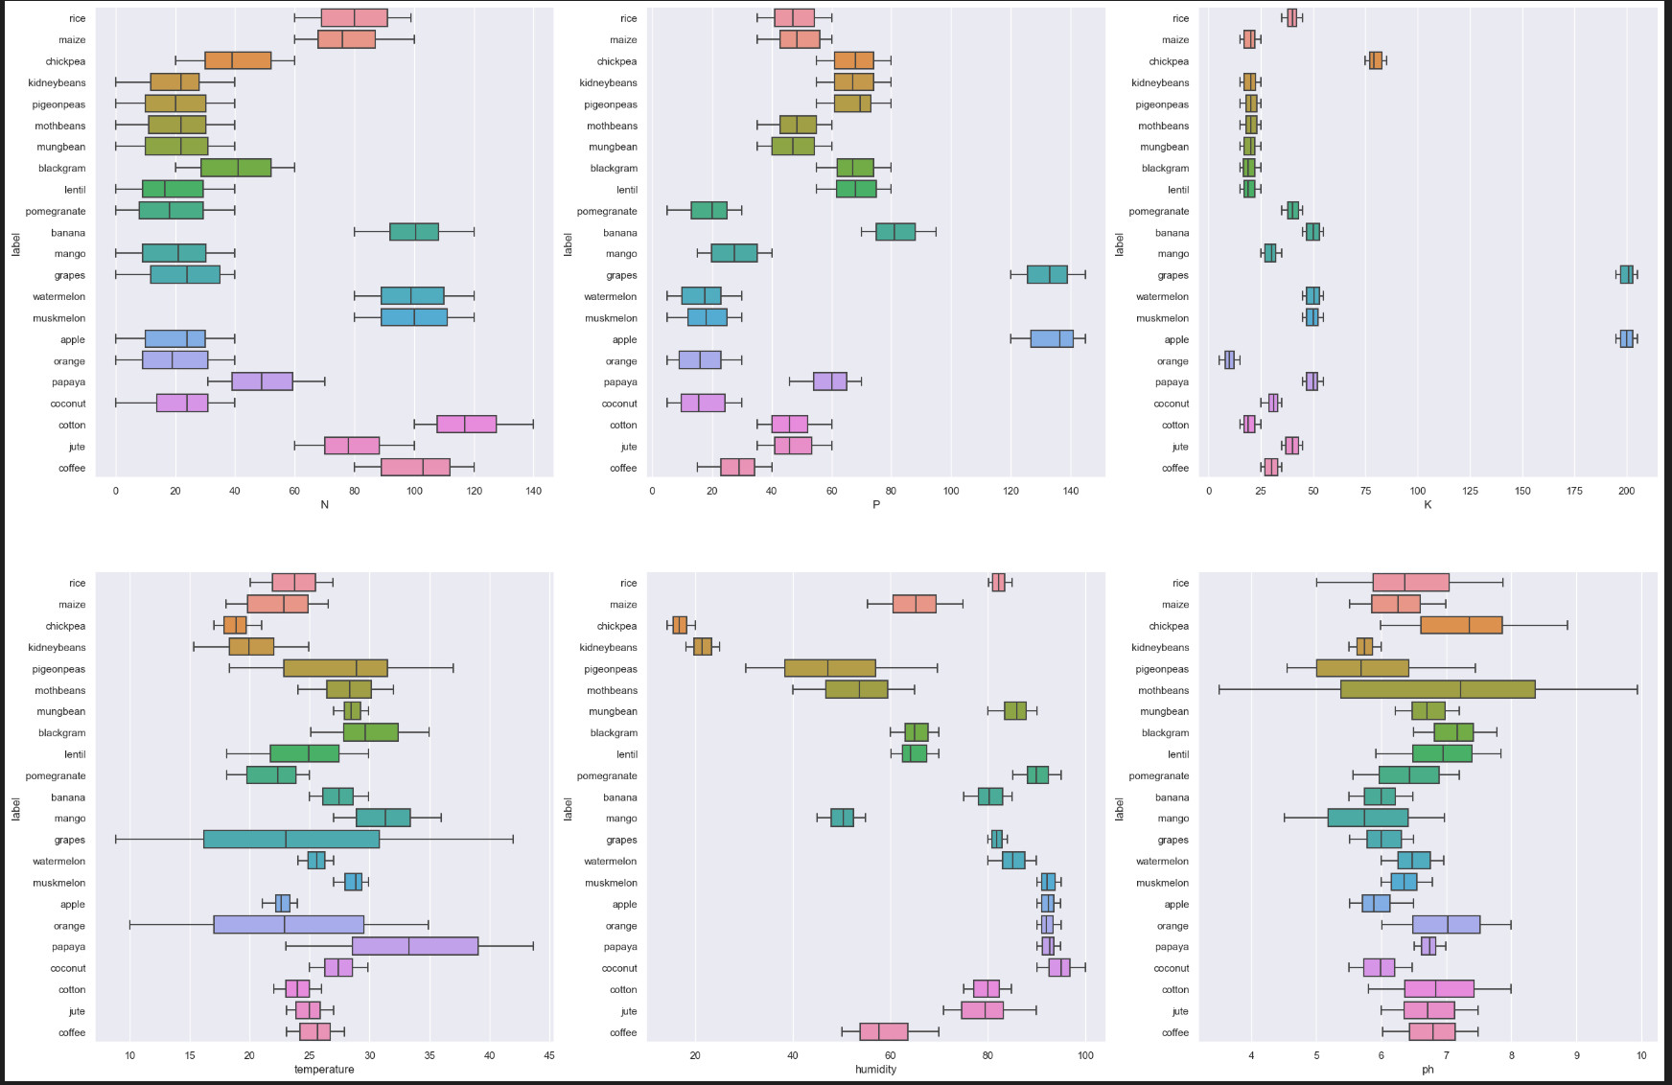
Box Plots:
Analyze feature spread for crop labels.

Slide 11

Limitations and Future Directions
While our analysis provides valuable insights, it is not without limitations. Future research could explore additional datasets, incorporate advanced modeling techniques, and address data quality issues to further improve the accuracy and robustness of crop recommendation systems.

Slide 12
conclusion
Machine learning enables accurate crop recommendations by analyzing data on soil attributes, climate conditions, and other relevant factors.
This capability enhances agricultural productivity and sustainability by empowering farmers to make informed decisions about crop selection, optimizing yields, and resource utilization.
Future directions involve exploring AI-driven solutions for addressing practical challenges in agriculture, such as crop diseases and climate variability.
The integration of AI models facilitates seamless engagement with suppliers, enabling farmers to access essential resources tailored to their specific needs, further enhancing efficiency and sustainability in agriculture.

Slide 13
References
Datasets:
Crop_recommendation.csv.
Libraries:
Pandas, NumPy, Matplotlib, Seaborn, scikit-learn, XGBoost, LightGBM, CatBoost.

Slide 14
Thank you

